Slide 1


Question of the day
With every breath we exhale water.
How much is this per day?
a. 400 ml
b. 250 ml
c. 80 ml

Slide 2
Correct answer: a.
Every day, humans lose around 400 ml of water
only by breathing. That's about 2 glasses of water per day!
How can this happen?
There is water vapor in your warm breath, usually invisible.
But if you are on a cold surface - e.g. window or mirror –
breathes condenses and you can see the water.
People do about 20,000 breaths per day and with each
exhalation we blow off water.
In total, that's almost half a liter of water a day!

Slide 3
Question of the day
Water content of the body
How much is it (percentage)?
a. 50 %
b. 66 %
c. 85 %

Slide 4
Correct answer: b
Around 60-66% of our body is water.
The water is distributed throughout our body.
All life processes require water.
For example, we need it as a means of solubilization and transportation to regulate
body temperature and eliminate harmful substances. Your body needs water every day!
We lose 2-3 liters of water every day - through sweating, breathing and urine.
We have to resume this amount.
About 1.5 - 2 liters of drinks and about 700 ml of solid food (which also contains water).

Slide 5
Question of the day
A drink with ice cubes refreshes best in the summer.
Right?

Slide 6
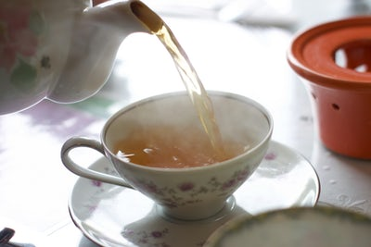
Correct answer: no
Explanation: The body has to heat up the ice-cold drink to body temperature. He needs energy for that.
Therefore, in hot countries warm tea
is drunk as a refreshment.

Slide 7
Question of the day
Drinking water helps you learning?
Correct?

Slide 8
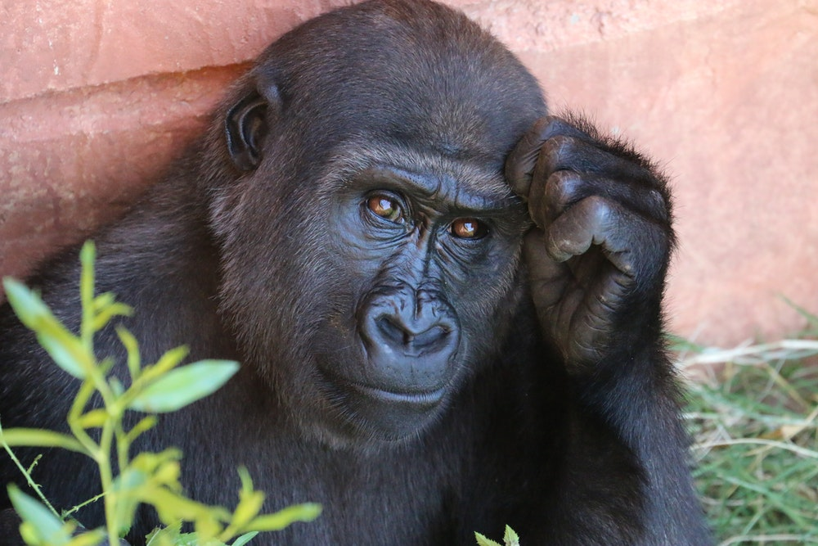
Correct answer: yes
Tests show that school achievement improves when students drink enough water.
With only 2% loss of water, our ability to think and concentrate already falls by 20%.
Why?
If we drink too little, our blood becomes thicker
and flows more slowly through the body.
As a result, oxygen and nutrients slow down
into the brain. We are tired, inattentive, the short-term
memory is deteriorating - even if we do not
immediately notice it.
Even the day after the watershortage our mental performance is reduced.

Slide 9
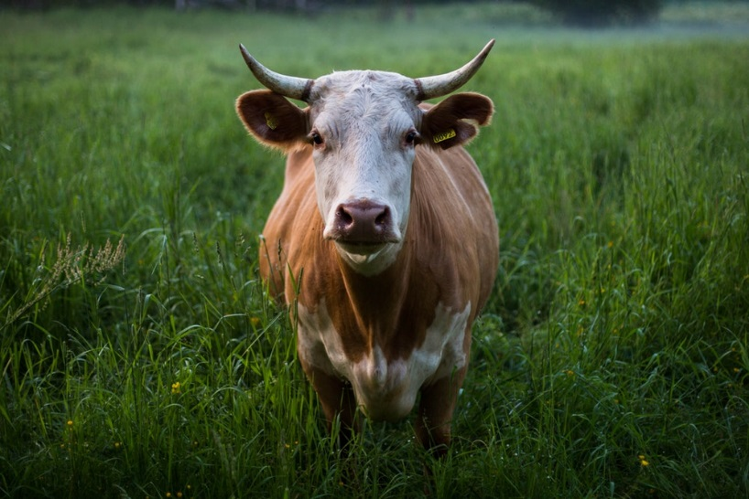
Question of the day
How much water do living organisms need?
A person needs 2-3 liters of water a day. How much water does a cow drink each day?
a. 10 liters
b. 60 liters
c. 150 liters.

Slide 10
Correct answer: c
A cow needs up to 150 liters of water on warm days.
All livings consist to a large extent of water.
People and animals die of thirst, plants wither if they do not get water. They all need water.
• A big tree needs 500 - 1,000 liters of water on a warm summer day.
• A human needs to drink about 2 liters of water a day.
• A cat needs about 200 ml of water a day.
• A bird or a mouse only needs a few milliliters a day, a few drops.

Slide 11
Question of the day
How old is our water?
a. Thousands of years
b. Millions of years

Slide 12
Correct answer: b
Every water molecule on earth or in your body is many millions of years old. The dinosaurs have already bathed in the same water we drink.
Our water is in the eternal cycle:
The amount of water on earth remains the same. Nothing disappears, none comes to it.
The heat of the sun evaporates water from the seas and lakes.
Water vapor rises, cools and forms clouds.
As rain or snow, water falls down to earth and seeps into the ground.
As a source, it comes out of the ground again and becomes a brook.
The stream flows into a river that ends in a lake or a sea.
Here the cycle starts again.

Slide 13
Question of the day
Water is extraterrestrial, it comes from outer space.
Is that correct?

Slide 14
Correct answer: yes
Water probably came to Earth from space through asteroids.
Where exactly these asteroids came from, which should have brought the water to the earth, is not known yet...
Fact is:
The earth is two-thirds covered with water and it is the only planet in our solar system where there is liquid water.
This water is the basis for life on earth.

Slide 15
Question of the day
Those who drink less do not sweat so much.
Is that correct?

Slide 16
Correct answer: no
The body sweats when it gets too warm.
No matter how much we drank.
Sweating is our "air conditioning": When you sweat water comes out of your skin. This water cools your skin, because it creates evaporation cold.
Investigation of soldiers with a long desert march:
1st group was allowed to drink when and as much as they wanted.
2nd group was allowed to drink only after the march.
The soldiers of the 1st group sweated 5.2 liters of water.
The soldiers of group 2 sweated 4.7 l of water (almost the same amount), but they were less efficient, more tired and duller.
Adolf 1947, Associates, Physiology of man in the desert, New York

Slide 17
Question of the day
How many calories does water have?
a. 0 kcal per liter
b. 100 kcal per liter
c. 400 kcal per liter

Slide 18
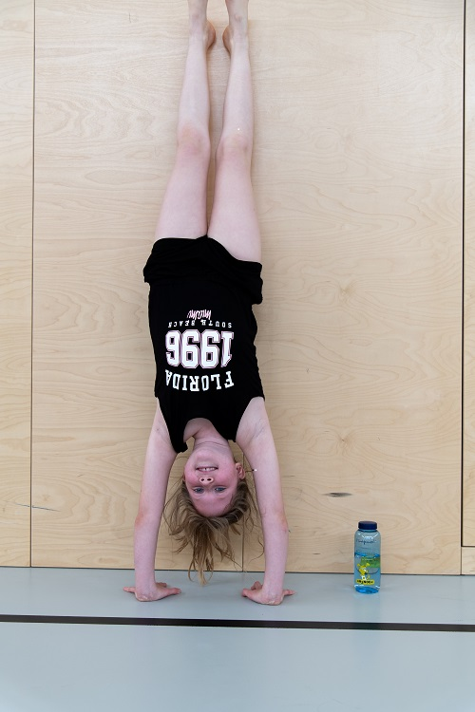
Correct answer: 0 kcal
Zero calories, zero fat and zero sugar.
Water is the lowest calorie soft drink.

Slide 19
Question of the day
Do sweetened drinks make you overweight?
Yes
No

Slide 20
Correct answer: yes
Those who consume sweetened drinks regularly have a higher risk of being overweight..
Why?
Highly sweetened drinks deliver a lot of calories because of the high sugar content. A bottle of soda (500 ml) brings it to approx. 200 kcal. As many calories as 4 apples.
Think about it:
How fed are you when you eat 4 apples at once? Probably pretty full.
How fed are you when you drink a bottle of soda? Presumably you can still have something to eat.
Calories in liquid form hardly saturate. As a result, we overeat and ingest too many calories. Evolution simply did not prepare us for the consumption of soft drinks!

Slide 21
Question of the day
Energydrinks keep you awake.
True?

Slide 22
Correct answer: no
Energy drinks only make you feel good for a short time.
Test with driving simulator - Comparison of energy drink, coffee and break:
Scientists gave people in the evening drinks with different caffeine and sugar content (coffee, energy drink, water). Then the testers had to drive for 6 hours in a driving simulator. After 2 hours there was a 30 minute break.
Result:
Drivers who had caffeine were more alert, keeping the track better.
When the caffeine was combined with sugar (energy drink), the drivers quickly got tired again. The more sugar added, the faster the fatigue!
After the break the riders were as fit as at the beginning of the test!
Best is taking breaks and drinking water. Worst of all: energy drinks!

